Slide 1
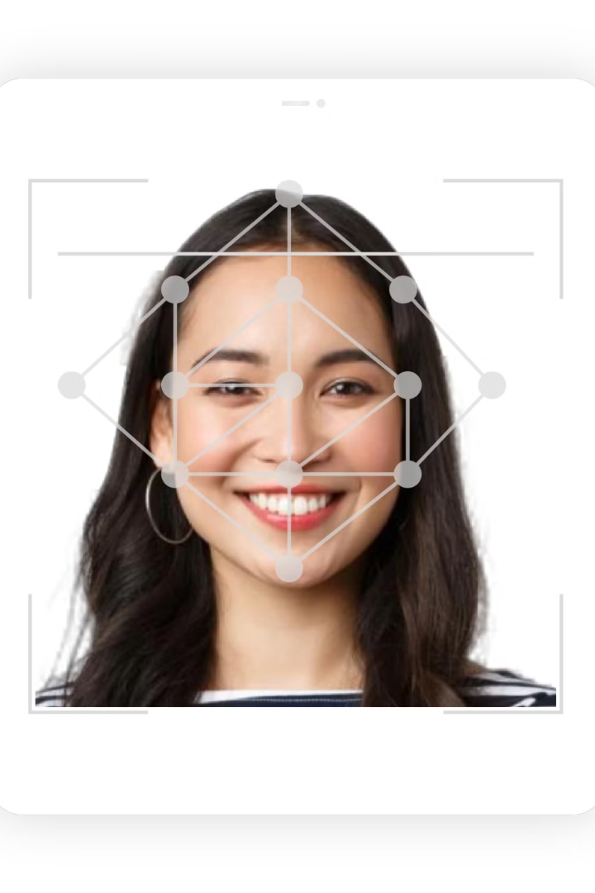

Requirments Gathering and
Stake holder Analysis
For A Mobile-Based Attendance Management System
Presentation by Group IV
Course Instructor: Dr. NKEMENI VALERY

Slide 2


Introduction
Focus: Mobile-based attendance system using geo-fencing and facial recognition
Goal: Improve accuracy, prevent proxy attendance, and offer real-time tracking
Scope: Only the requirements gathering phase is covered
Aim: Gather requirements for a secure, automated mobile attendance system

Slide 3

Current Challenges in Attendance Tracking
Time-Consuming
Prone to Manipulation
Manual sign-in sheets waste valuable class time and require additional effort to compile.
Traditional systems are vulnerable to proxy attendance and impersonation.
Lack of Real-Time Data
Current methods don't provide immediate access to attendance records.

Slide 4








Key Stakeholders
Students
Instructors
Primary users concerned with privacy, ease of use, and device performance.
Need real-time viewing, filtering of attendance data, and identifying proxy attendance.
Academic Administrators
Development Team
Require comprehensive analytics and secure data storage mechanisms.
Responsible for building, testing, and maintaining the mobile application.

Slide 5
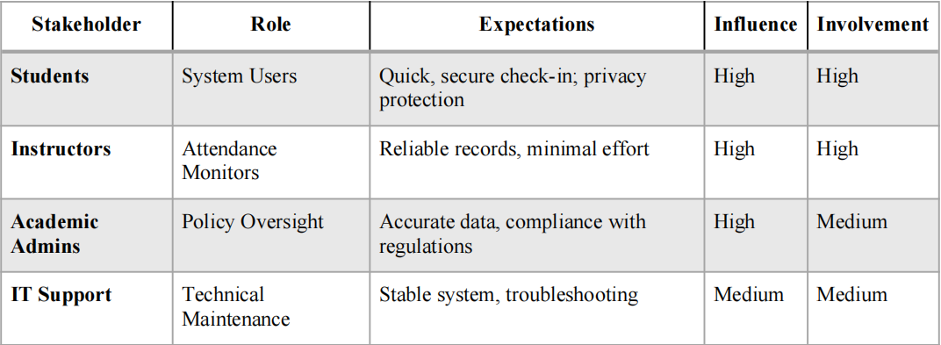

Stakeholder Matrix Summary

Slide 6





Requirement Gathering Techniques
Interviews
Direct conversations with lecturers and students to gather in-depth insights.
Surveys/Questionnaires
Structured data collection from 86 students and staff members.
Brainstorming
Group discussions to generate feature ideas and edge case considerations.
Reverse Engineering
Analysis of existing systems like Geo-Attend Pro to understand functionality.

Slide 7

Data Gathering Overview
Combined Data Sources
Primary and secondary data collected for comprehensive insight.
Tools Used
Google Forms, Microsoft Word, and app analysis to gather feedback.
Target Groups & Participation
Surveyed 86 students and interviewed 12 staff and students.
Key Concerns
Focus on privacy, usability, and system reliability.

Slide 8
Tools Used & Challenges Faced
Data Collection Tools
Challenges
Solutions
App Review
Google Forms for surveys
Low response rates hampered sample size
Follow-up reminders to participants
Studied Geo-Attend Pro to benchmark common features.
Microsoft Word for structured interviews
Restricted access to institutional documents
Peer referrals increased engagement
App stores for system analysis

Slide 9

Data Cleaning Process
Initial Cleaning
Removal of duplicates and incomplete responses.
Standardization
Normalized responses for consistency (e.g., “Yes” formatting).
Categorization
Grouped feedback into thematic categories.
Tools Employed
Excel and Python scripts automated the data cleaning tasks.

Slide 10

Results & Insights
Accurate Dataset
Insight Identification
Ensured data integrity for reliable analysis.
Detected key user features such as real-time check-ins.
Foundation for Development
Data informed functional and non-functional requirements.

Slide 11


Key Findings
Preference for facial recognition and GPS-based check-ins
Concerns over privacy and parent notifications
Desire for quick, seamless, and reliable check-ins
Support for instructor override and real-time features

Slide 12
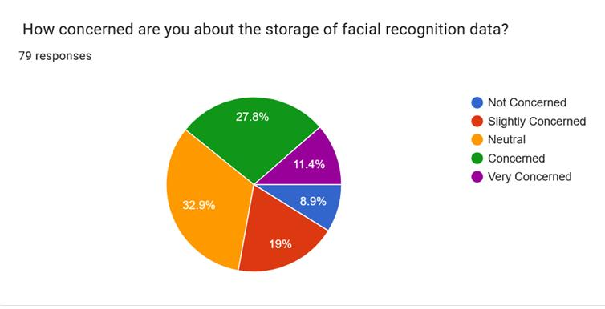
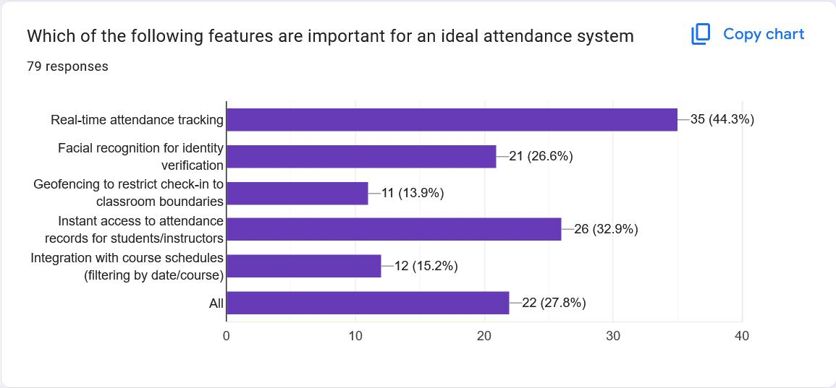


Slide 13
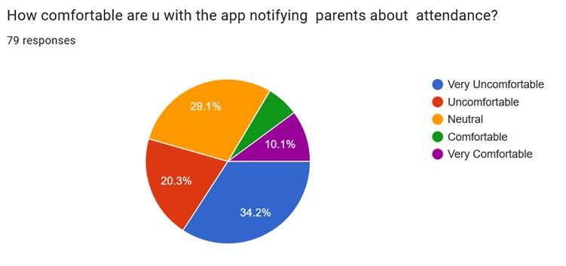


Slide 14





User Reluctance Factors
Privacy Concerns
Many students expressed worry about the storage of facial recognition data.
GPS Tracking
Mixed responses about geo-location tracking, with some viewing it as intrusive.
Parent Notifications
Notable portion uncomfortable with attendance being reported to parents.
System Reliability
Doubts about accuracy of facial recognition in various environments.

Slide 15




Mitigation Strategies
Enhanced Privacy Controls
Encrypt data and show clear privacy policies in-app.
Consent-Based Tracking
Limit GPS tracking to check-in events only.
Optional Notifications
Make parental notifications user-controlled.
Backup Features
Include manual override options for technical failures.

Slide 16





Functional Requirements
User Registration/Login
Secure login and registration for students and instructors.
Facial Recognition Check-in
Students check-in by scanning their face via their phone's camera.
Geo-fencing Verification
Attendance valid only if user is within the classroom zone.
Real-time Attendance View
Instructors can view and track attendance in real-time.

Slide 17










Non-Functional Requirements
Speed
Check-in process under 5 seconds
Data Privacy
Secure storage and encryption
Compatibility
Works on Android (and iOS)
Availability
99% uptime during school hours
Usability
Intuitive interface for all users

Slide 18
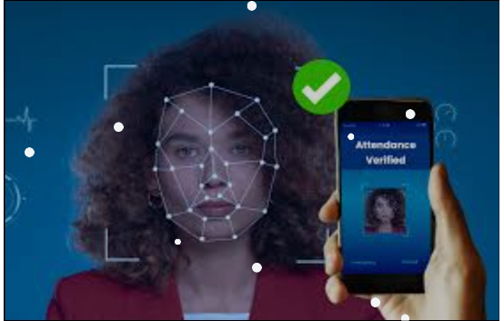


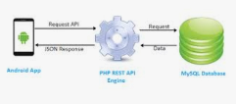
Technical Requirements
Integration with GPS and facial recognition API
Secure authentication (optional 2FA)
Cloud database
REST API for mobile-backend communication

Slide 19








Next Steps
System Modeling
Architecture Design
Create detailed technical designs based on gathered requirements.
Develop the technical framework for the application.
Testing & Validation
Implementation
Ensure quality through comprehensive testing procedures.
Build the system according to specifications.

Slide 20
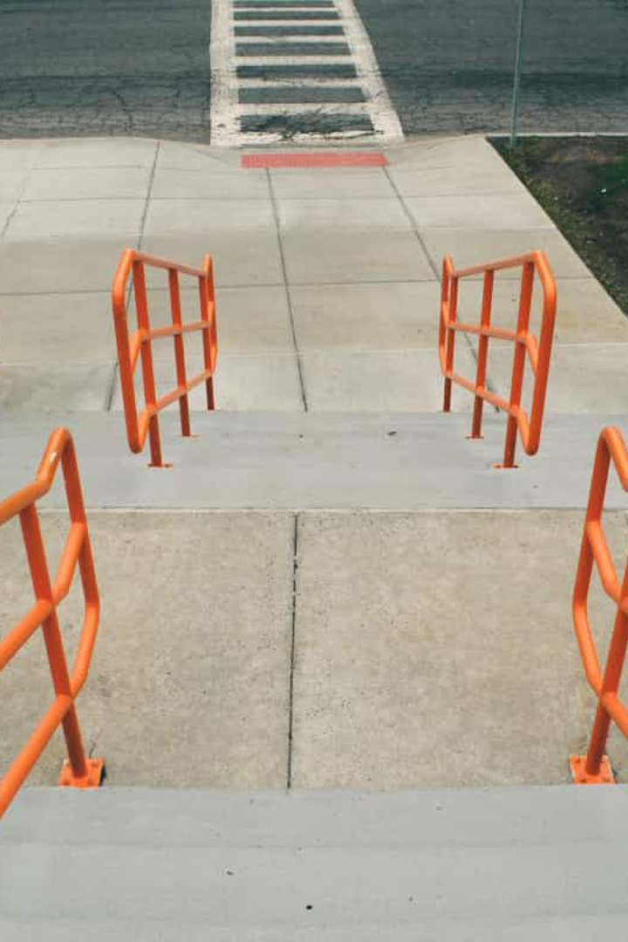
Thank You
Questions? We welcome your feedback and discussion.

